Slide 1

IBM WATSON STUDIO FOR BUILDING AN AUTOMATED ESSAY GRADING SYSTEM MINI PROJECT
Presented By:
18UK1A05D5 - Gundavaram Rahul
18UK1A05B3-Thammishetty Soumya
18UK1A05D7-Jakkula Pausha
18UK1A05A3-Gunda Rohith

Slide 2

AGENDA
Introduction
Purpose
Existing problem
Proposed Solution
Block Diagram
Software Requirements
Flowchart
Result
Conclusion
Future scope
References

Slide 3
INTRODUCTION
Essays are considered as one of the main evaluation criteria used by teachers to evaluate student’s performance. Essay evaluation is a time consuming process, a teacher denotes a huge amount of time in evaluation of essays because of its subjectivity. Also because of subjective nature of the essay variation in grades usually occurs. Solution to such problem is automatic essay evaluation. Evaluating essays through computer will help reducing teachers load as well as reduce the variation in grades as a result of human factors. Many system were developed/ proposed to check the writing quality of the essays some of the mentions are Project Essay Grade (PEG), Intelligent Essay Assessor (IEA), Educational Testing service I, Electronic Essay Rater (E-Rater), C-Rater, BETSY, Intelligent Essay Marking System, SEAR, Paperless School free text Marking Engine and Auto mark etc. Most of them are either commercially available or under development.

Slide 4
PURPOSE
Essays are one of the most important method for assessing learning and intelligence of a student. The automated grading system will not only reduce the time of evaluation but comparing it with human scores will also make the score more realistic. The project aim is to develop a system which grades an essay or a paper without any manual involvement. When an essay is loaded into the proposed grading system, the system accepts the essay given as the input and grades it using deep learning techniques and its layers such as LSTM and dense layers. This proposed system is useful while grading papers in smart schools and educational institutions.

Slide 5
EXISTING PROBLEM
Data collection was not a problem. A minor problem occurred during cleaning the data like for our model two steps cleaning is required one for converting essay into list of words and second for converting essay into list of sentences. In first case punctuations(like ., ?, !) were not needed in second case punctuations(like ., ?, !) were required to break into sentences. Feature extraction is complicated and lengthy, but no problem occurred. So to grade the essay there will be a lot of complication like to check spellings, punctuations, sentence formations, and the essay in correct format and relevant to the question. So, this is the existing problem and for this we have proposed a particular solution.

Slide 6
PROPOSED SOLUTION
We used tensor flow to build our model. We used the baseline model to predict scores for the given essays rather than giving feedback .we then feed these embeddings to the multi layered LSTM .Then we feed the output of the LSTM layer to the fully connected layer. An automated grading system is built with the magical powers of neural networks. Using automation reduces time and effort in evaluation. NLTK libraries for feature extraction and LSTM are used for the learning process.

Slide 7
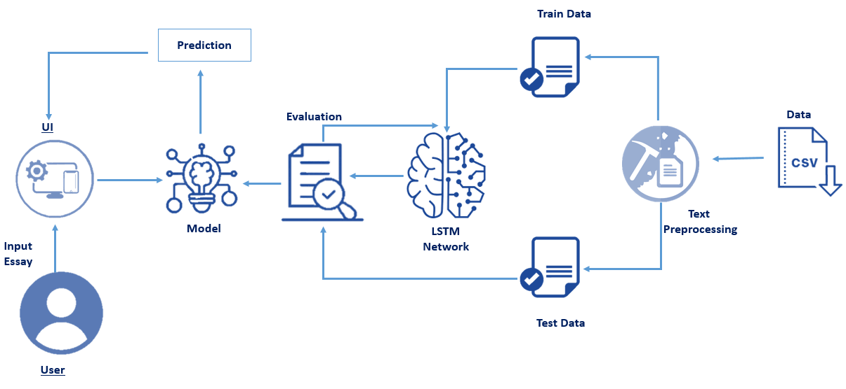
BLOCK DIAGRAM

Slide 8
SOFTWARE REQUIREMENTS
Anaconda Navigator
Jupyter Notebook
IBM Watson studio
NLTK
Machine Learning Tools like
Scikit Learn
Vader
Tensor Flow
PyEnchant
Pandas
Numpy

Slide 9
TECHNIQUES
Recursive feature elimination with cross-validation
Random forest for regression
SVR from Scikit Learn
LSTM from Tensor Flow
AdaBoost from Scikit Learn

Slide 10
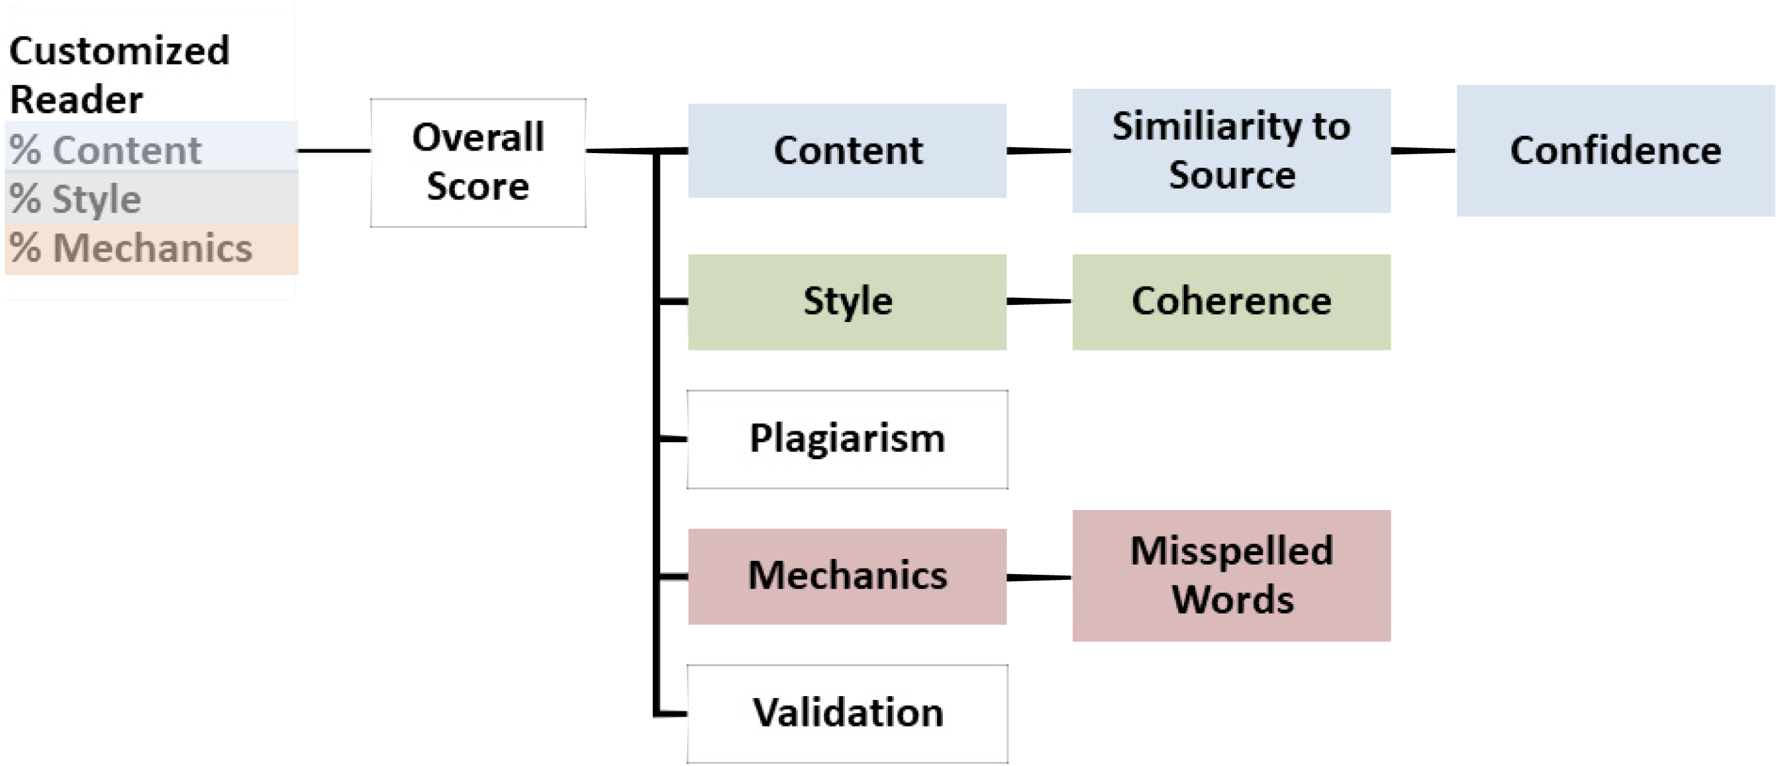
FLOW CHART

Slide 11
SOURCE CODE
https://github.com/smartinternz02/SI-GuidedProject-5807-1634107621

Slide 12
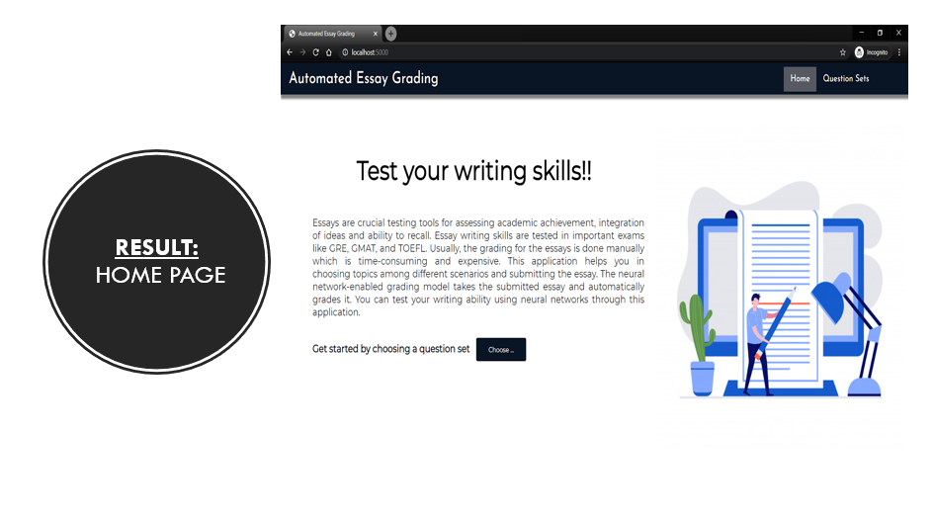

Slide 13
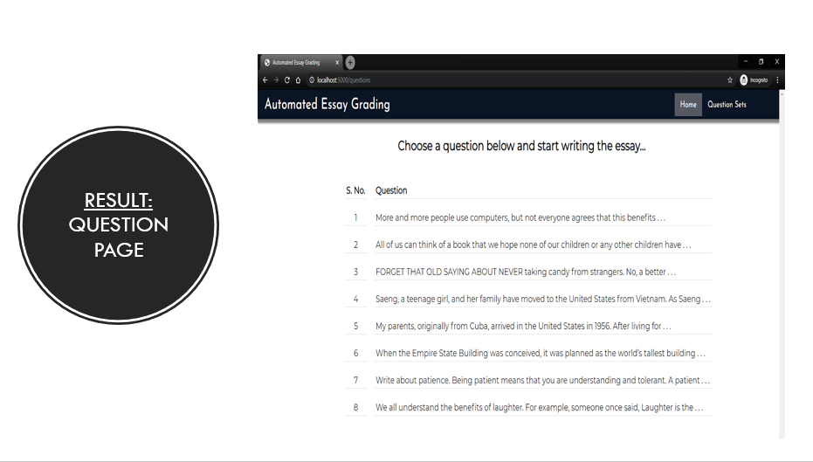

Slide 14
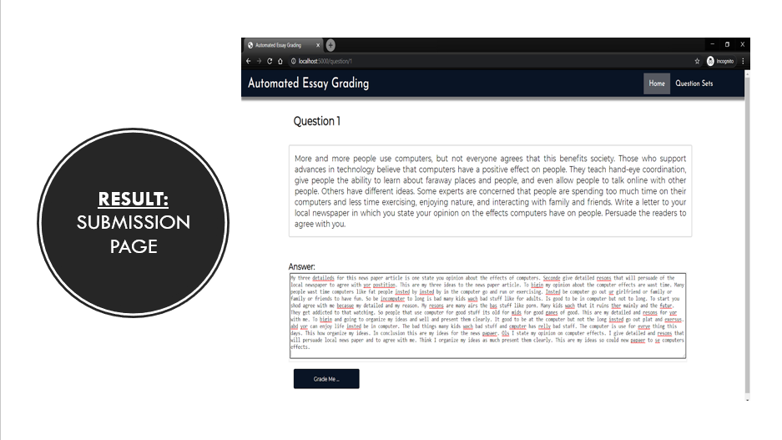

Slide 15
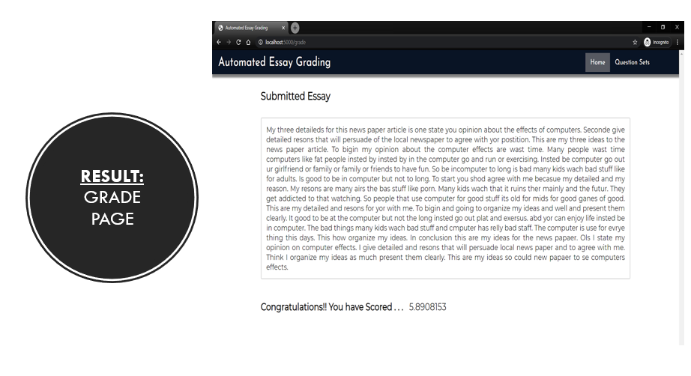

Slide 16
CONCLUSION
Our model gives out good predictions on the basis of the features considered such as word count, sentence count, prevalence, parts of speech count. The performance on context and sentiment rich essays can be made better by better training our model with larger and more complex datasets and advanced NLP features. The average weighted kappa we have achieved by using this process is above 0.5 which is normally ideal.

Slide 17
FUTURE SCOPE
The future scope of the given problem can extend in various dimensions. One such area is to search and model good semantic and syntactic features. For this, various semantic parsers etc. can be used. Other area of focus can be to come up with a better tool than linear regression with polynomial basis functions like neural networks etc.

Slide 18
REFERENCES
Page, E.B. (2003). "Project Essay Grade: PEG", p. 43. In Sherm's, Mark D., and Jill Burstein, eds., Automated Essay Scoring: A Cross-Disciplinary Perspective. Lawrence Erlbaum Associates, Mahwah, New Jersey, ISBN 0805839739
Greenwald, A. R. (2007). Learning how to argue: experiences teaching the Toulmin model to composition students [Retrospective Theses and Dissertations 14521, Iowa State University]. https://lib.dr.iastate.edu/cgi/viewcontent.cgi?article=15520&context=rtd
Automatic Essay Grading By Space Explorers Sahil Chelaramani – 20162051 Pranav Dhakras – 20162303 Josyula Gopalkrishan – 20162137
Automated essay grading by Siyuan Zhao - https://github.com/siyuanzhao/automated-essay-grading

Slide 19

THANK YOU

